Slide 1
NFL Big Data Bowl
By Darius Parker, Eboni Mangum & Josh Edwards

Slide 2
What is the NFL Big Data Bowl?
Contestants use Next Gen Stats player tracking data to generate actionable, creative, and novel stats
Previous years looked at running backs, defensive backs, special teams, pass rush plays, and tackling
Metrics have been used on television and by NFL Teams

Slide 3
2025 NFL Big Data Bowl
Focus
What happens before the snap
Goal
Generate creative insights and actionable predictions into what the offense or defense does after the snap

Slide 4
Project Background
NFL Offenses have 40 seconds to run a play
Pre-snap both teams must execute:
Player substitutions
Communicate plays
Read the field
Determine optimal strategy for player formations

Slide 5
Problem Statement
Our Focus
Analyze NFL team tendencies on 3rd down
What are the Influences that determine a running vs pass play
Identify patterns and probabilities associated with 3rd down play-calling strategies
Objective
Actionable insights regarding 3rd down play calls by identifying patterns in play-calling behaviors
Quantify the probability of a team opting to run or pass in different scenarios

Slide 6
OUR GOALS
Identify common patterns in play-calling strategies on 3rd down
Quantify the 3rd down probability of running vs passing
Develop actionable insights and recommendations to improve 3rd down strategies
01
02
03

Slide 7
Our Prediction
NFL teams are more likely to pass the ball on 3rd down than run the ball

Slide 8
Data Exploration
2022 NFL Season
Total Plays
Dataset
3rd Down Plays
Weeks 1 – 9
136 Unique Games
16, 124 Total Plays
60% Pass, 40% Run
16,124 Rows
50 Columns
3,279 Total Plays
80% Pass, 20% Run

Slide 9
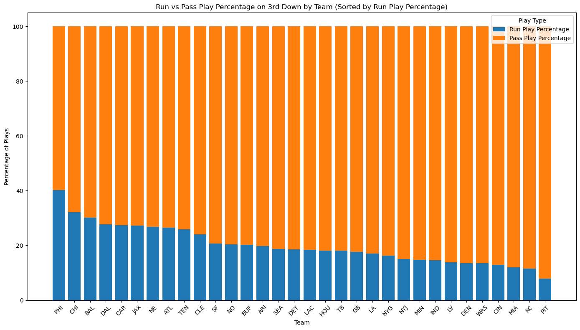
3rd down by TeamComparison
Eagles
40%
Highest run rate
Steelers
8%
Lowest run rate

Slide 10
Yards until first down for run/pass percentage
Pass plays jump to greater than 90% when teams have 4 or more yards to go
Yards To Go | Total Plays | Pass Plays | Run Plays | Run Play | Pass Play
1 | 411 | 111 | 300 | 73% | 27%
2 | 284 | 184 | 100 | 35% | 65%
3 | 256 | 196 | 60 | 23% | 77%
4 | 271 | 245 | 26 | 10% | 90%
5 | 313 | 284 | 29 | 9% | 91%
6 | 236 | 217 | 19 | 8% | 92%
7 | 244 | 222 | 22 | 9% | 91%
8 | 220 | 206 | 14 | 6% | 94%
9 | 191 | 178 | 13 | 7% | 93%
10 | 258 | 250 | 8 | 3% | 97%
11 | 107 | 101 | 6 | 6% | 94%
12 | 95 | 79 | 16 | 17% | 83%
13 | 67 | 61 | 6 | 9% | 91%
14 | 55 | 50 | 5 | 9% | 91%
15 | 66 | 61 | 5 | 8% | 92%
15+ | 205 | 179 | 26 | 13% | 87%

Slide 11
Run % on 3rd down for New York Giants
Giants appear to have a more balanced approach on '3rd & 1', '3rd & 2', and '3rd & 8'
Yards To Go | NYG Run %
1 | 67%
2 | 60%
3 | 17%
4 | 11%
5 | 8%
6 | 0%
7 | 11%
8 | 50%
9 | 11%
10 | 10%
11 | 0%
12 | 50%
13 | 0%
14 | 0%
15 | 0%
15+ | 0%

Slide 12
Supervised Machine Learning
 | Decision Tree
 | Precision | Recall | F1-score
0 (Pass) | 0.92 | 0.82 | 0.87
1 (Run) | 0.58 | 0.76 | 0.66
Accuracy |  |  | 0.81
Macro avg | 0.75 | 0.79 | 0.76
Weighted av | 0.84 | 0.81 | 0.82
 | Random Forest
 | Precision | Recall | F1-score
0 (Pass) | 0.92 | 0.87 | 0.9
1 (Run) | 0.66 | 0.77 | 0.71
Accuracy |  |  | 0.82
Macro avg | 0.79 | 0.82 | 0.8
Weighted av | 0.86 | 0.85 | 0.85
 | Logistic Regression
 | Precision | Recall | F1-score
0 (Pass) | 0.93 | 0.85 | 0.89
1 (Run) | 0.62 | 0.8 | 0.7
Accuracy |  |  | 0.83
Macro avg | 0.76 | 0.8 | 0.77
Weighted av | 0.84 | 0.82 | 0.83

Slide 13
Supervised Machine Learning Cont.
 | Gradient Boosted Trees
 | Precision | Recall | F1-score
0 (Pass) | 0.92 | 0.84 | 0.88
1 (Run) | 0.6 | 0.75 | 0.67
Accuracy |  |  | 0.82
Macro avg | 0.76 | 0.8 | 0.77
Weighted av | 0.84 | 0.82 | 0.83
 | MLP
 | Precision | Recall | F1-score
0 (Pass) | 0.87 | 0.95 | 0.91
1 (Run) | 0.76 | 0.54 | 0.63
Accuracy |  |  | 0.85
Macro avg | 0.81 | 0.74 | 0.77
Weighted av | 0.84 | 0.85 | 0.84
 | Ensemble
 | Precision | Recall | F1-score
0 (Pass) | 0.99 | 0.99 | 0.99
1 (Run) | 0.8 | 0.87 | 0.83
Accuracy |  |  | 0.98
Macro avg | 0.89 | 0.93 | 0.91
Weighted av | 0.98 | 0.98 | 0.98

Slide 14
Predicting Run vs. Pass for Teams
 | NYG
 | Precision | Recall | F1-score
0 (Pass) | 0.96 | 0.94 | 0.95
1 (Run) | 0.56 | 0.64 | 0.6
Accuracy |  |  | 0.91
Macro avg | 0.76 | 0.79 | 0.77
Weighted av | 0.92 | 0.91 | 0.91
 | NYJ
 | Precision | Recall | F1-score
0 (Pass) | 0.99 | 0.95 | 0.97
1 (Run) | 0.5 | 0.83 | 0.62
Accuracy |  |  | 0.95
Macro avg | 0.74 | 0.89 | 0.8
Weighted av | 0.96 | 0.95 | 0.95
 | PHI
 | Precision | Recall | F1-score
0 (Pass) | 0.89 | 0.96 | 0.92
1 (Run) | 0.97 | 0.91 | 0.93
Accuracy |  |  | 0.93
Macro avg | 0.93 | 0.93 | 0.93
Weighted av | 0.93 | 0.93 | 0.93

Slide 15
Predicting Location of Runs/Passes
Rush Location Type | Count | Percentage
Inside Left | 212 | 29.99%
Inside Right | 21 | 29.84%
Outside Right | 149 | 21.07%
Outside Left | 135 | 19.09%
Pass Location Type | Count | Percentage
Inside Box | 1684 | 85.40%
Outside Right | 176 | 8.92%
Outside Left | 112 | 5.68%
Models struggled to predicting rush locations due to an imbalance of passes vs. runs.
Predicting the location of passes may not be needed. Teams pass to 'Inside box' 85% of the time.

Slide 16
Importance of Traditional Statistics
Machine learning is not always the answer.
Better insights from general statistics.
K.I.S.S. (Keep it simple...)

Slide 17
THANKS!
Please keep this slide for attribution

